Slide 1
Mobile Application Threat Analysis
Simon Lyhin

Slide 2
The life of an ethical hacker
Bad News
Ethics
Hacking

Slide 3
L_L
Each Admin deploys software any Researcher may try to break
A strategic place to develop skills SLOWLY
Obligatory performance and reporting standards
NON-COMMERCIAL and FREE OF CHARGE, forever.
https://lyhinslab.org
simon@lyhinslab.org

Slide 4
What can we do with an app?

Slide 5
What kinds of value can we get?

Slide 6
How to audit the whole attack surface?

Slide 7
Web app security
Huge attack surface
Easily accessible from the Internet
Fully controlled and relatively stable systems

Slide 8
Mobile app security
Back-end is narrow-sized and is reachable for anybody
Client-side is controlled by independent humans, who make mistakes
Even though the back-end is far more important, clients still need to be secure.

Slide 9
Client-side security matters! COVID19 proofed it.

Slide 10
Executive Summary
The threat groups of:
1. The back-end security
2. The application itself
3. The malware
4. The stolen device
5. The external attacker

Slide 11
Client-side security

Slide 12
Impact
Can be measured in terms of money,
What percentile of users can be compromised?
What kinds of reputational damage/benefits can we get?

Slide 13
Closeness
1
0
1
Adaptability

Slide 14
Closeness
The Stolen Device
The Malware
1
The Application itself
The External Attacker
0
1
Adaptability

Slide 15
What are the minimum Closeness and Adaptability required for the exploitation?

Slide 16
Closeness
The Stolen Device
The Malware
1
The Application Itself
The External Attacker
0
1
Adaptability

Slide 17
Cases

Slide 18
The Application Itself

Slide 19
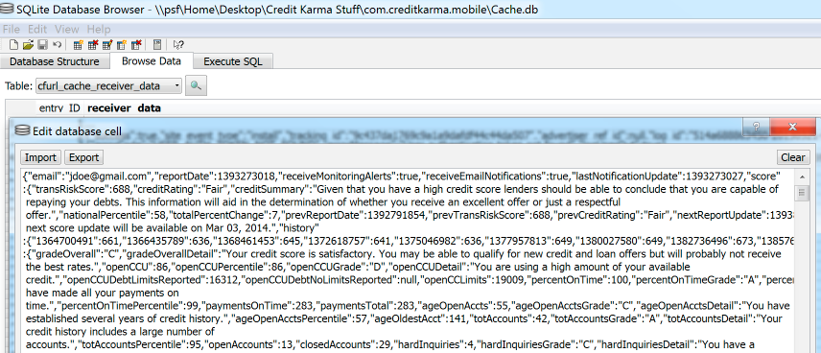
The Stolen Device Threat

Slide 20
The Malware Threat

Slide 22
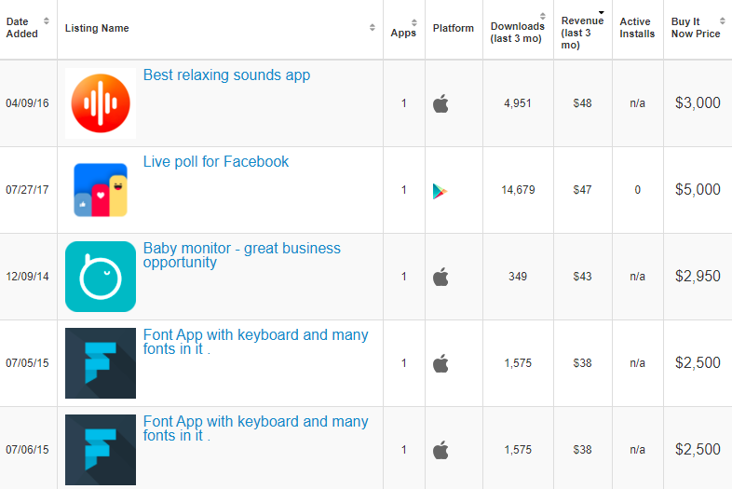
The Malware Threat

Slide 23
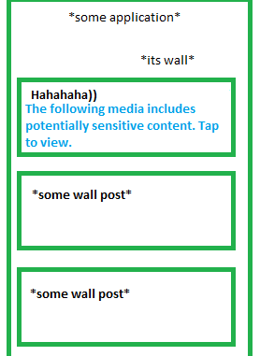
The External Attacker Threat

Slide 24
Conclusions

Slide 25
Building of the basic attack surface
Use these angles to look at the application, add some creativity and build an accurate attack surface.

Slide 26
Building of the basic attack surface
The Malware: based on IPC
The Stolen Device: based on assets the application keeps on the device, based on known misconfigurations.
The External Attacker: based on in-app actions, based on networking
The Application Itself: based on permissions, based on regular traffic.

Slide 27
Credits & Contacts
This talk was inspired by conversations with:
Christopher Crowley at SANS sec575, Anaheim, CA, early 2020
Offensive Security AWAE&CTP courses & communities
Real-life projects from the company I’m currently work in.
And hours of conversations with Lyhin’s Lab members.
simon@lyhinslab.org
@garumpage

